Slide 1
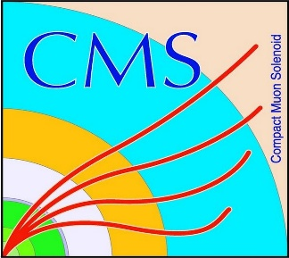

HEP Weekly Report
George Bakas
NTUA

Slide 2
Progress Report
DCS
CMSfwAlertSystem
When a user installs this component→ problem is that maybe notifications will be sent
Shut down notifications in non production systems
Main panel bug fixes and new implementations
Work on fwInstallationUtils component
DbEditor and Navigator tool: allows the installation of projects to hosts using the installation db
Changes/fixes in the panels
DCS FSM main panel at Shifter’s screen
FSM at P5 is operated by the shifter
Shifter’s credentials are read from a Card Reader
Sometimes shifters do not place their card correctly→ several emails that the FSM has no owner etc
Goal is to build a panel instructing the shifters how to correctly place their card

Slide 3
Progress Report
ArdEnvino
Finished with Tutorials
Sketch on how will the box be
Start to build it in Fusion 360
Analysis
No progress on MC without spin correlation yet

